Slide 1

Required Reading
Chapter 5: Starting a New App
Please read before Friday’s class
Notes:
In the Safari Collection.
Please read before next class.

Slide 2
Sensors
IN721 2017
Design and Development for Mobile Devices
Session 11.1

Slide 3
Android Sensors
TYPE_ACCELEROMETER | Measures the acceleration force in m/s² that is applied to a device on all three physical axes (x, y, and z), including the force of gravity. | Motion detection (shake, tilt, etc.).
TYPE_AMBIENT_TEMPERATURE | Measures the ambient room temperature in degrees Celsius (°C). See note below. | Monitoring air temperatures.
TYPE_GRAVITY | Measures the force of gravity in m/s² that is applied to a device on all three physical axes (x, y, z). | Motion detection (shake, tilt, etc.).
TYPE_GYROSCOPE | Measures a device's rate of rotation in rad/s around each of the three physical axes (x, y, and z). | Rotation detection (spin, turn, etc.).
TYPE_LIGHT | Measures the ambient light level (illumination) in lx. | Controlling screen brightness.
TYPE_LINEAR_ACCELERATION | Measures the acceleration force in m/s² that is applied to a device on all three physical axes (x, y, and z), excluding the force of gravity. | Monitoring acceleration along a single axis.
TYPE_MAGNETIC_FIELD | Measures the ambient geomagnetic field for all three physical axes (x, y, z) in μT. | Creating a compass.
TYPE_ORIENTATION | Measures degrees of rotation that a device makes around all three physical axes (x, y, z). As of API level 3 you can obtain the inclination matrix and rotation matrix for a device by using the gravity sensor and the geomagnetic field sensor in conjunction with the getRotationMatrix() method. | Determining device position.
TYPE_PRESSURE | Measures the ambient air pressure in hPa or mbar. | Monitoring air pressure changes.
TYPE_PROXIMITY | Measures the proximity of an object in cm relative to the view screen of a device. This sensor is typically used to determine whether a handset is being held up to a person's ear. | Phone position during a call.
TYPE_RELATIVE_HUMIDITY | Measures the relative ambient humidity in percent (%). | Monitoring dewpoint, absolute, and relative humidity.
TYPE_ROTATION_VECTOR | Measures the orientation of a device by providing the three elements of the device's rotation vector. | Motion detection and rotation detection.
TYPE_TEMPERATURE | Measures the temperature of the device in degrees Celsius (°C). This sensor implementation varies across devices and this sensor was replaced with the TYPE_AMBIENT_TEMPERATURE sensor in API Level 14
Notes:
Not all on all phones, of course.
One of the things the sensor classes allow you to do is check your specific phone for specific sensors and/or list all the sensors on your phone.
Here’s what is on the department’s S3s...

Slide 4
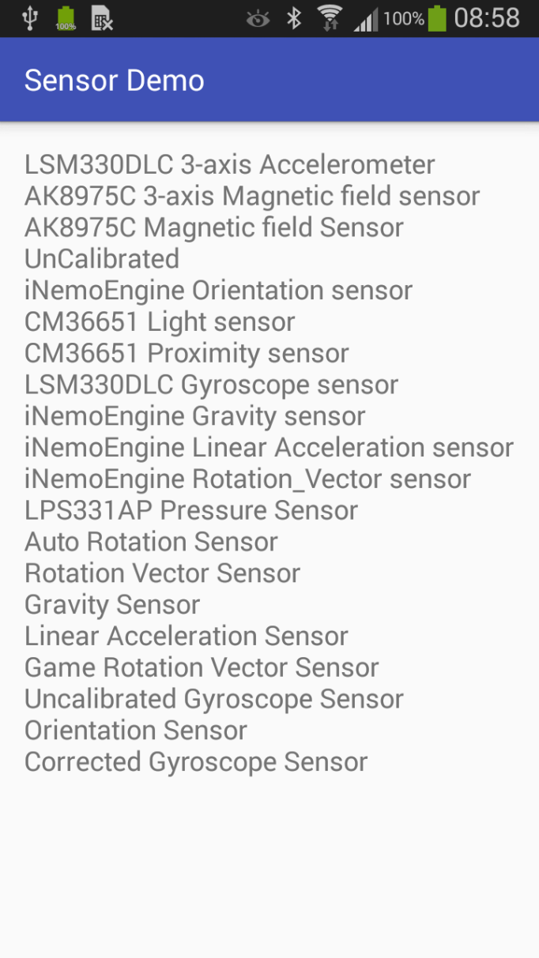
Android Sensors
Notes:
Some of these are “virtual sensors”. That is, they are software services that wrap the physical sensors. See docs for details.
The J5s have a lot fewer sensors, which is a complaint you often hear people make about them.

Slide 5
Practical – Explore Sensors
http://developer.android.com/guide/topics/sensors/sensors_overview.html
Notes:
Will be independent study…start here
The sensor classes are very powerful, but typically idiosyncratic for Android classes. They will do everything you need, and give you all the information you need, but you have to do it their way, as usual.

Slide 6
Practical – Explore Sensors
Pair (or Triplet)
In-class
Individual
Due Friday by 10.00 am
Notes:
Will be independent study…
The sensor classes are very powerful, but typically idiosyncratic for Android classes. They will do everything you need, and give you all the information you need, but you have to do it their way, as usual.

Slide 7
Practical – Explore Sensors
Implement the following functionality:
Group:
List all sensors on the phone.
If you have a light sensor:
Display the illumination level.
Confirm that the value changes as you move the phone from
light to shade.
If you have a proximity sensor:
Display “Near” when the phone is < 5.0 cm from a surface
(e.g. your hand) and “Far” when it is > 5.0 cm from a
surface.
Display the x, y and z tilts (using the accelerometer).
Notes:
You can write separate apps for each one, or combine 2/3 & 4

Slide 8
Practical – Explore Sensors
Individual:
Create a movement animation that responds to tilt on the x and y axis.
Notes:
For the individual task: The simplest option is an imageview that moves around the screen in response to tilt.
That is sufficient to get full marks.
However, you might want to experiment with more interesting behaviors – e.g. collisions, or combining it with illumination so that the image moves faster in the light, or whatever. We will have time to look at these in class.

Slide 9
Technical Note
You will find some examples where the sensor event handlers are written as part of the Activity. That is:
public class SensorActivity extends Activity
implements SensorEventListener
Do not do this. Implement your handlers as inner classes.
In the individual task, provide correct handlers for onPause and onResume. Be prepared to explain why these are so important.
Notes:
The “all-in-one” is easier, but much less flexible. You can work out how to do it the more elegant way.
If you need a phone, we have three available. You may have to share.

